Slide 1
Supervisions/revision

Slide 2
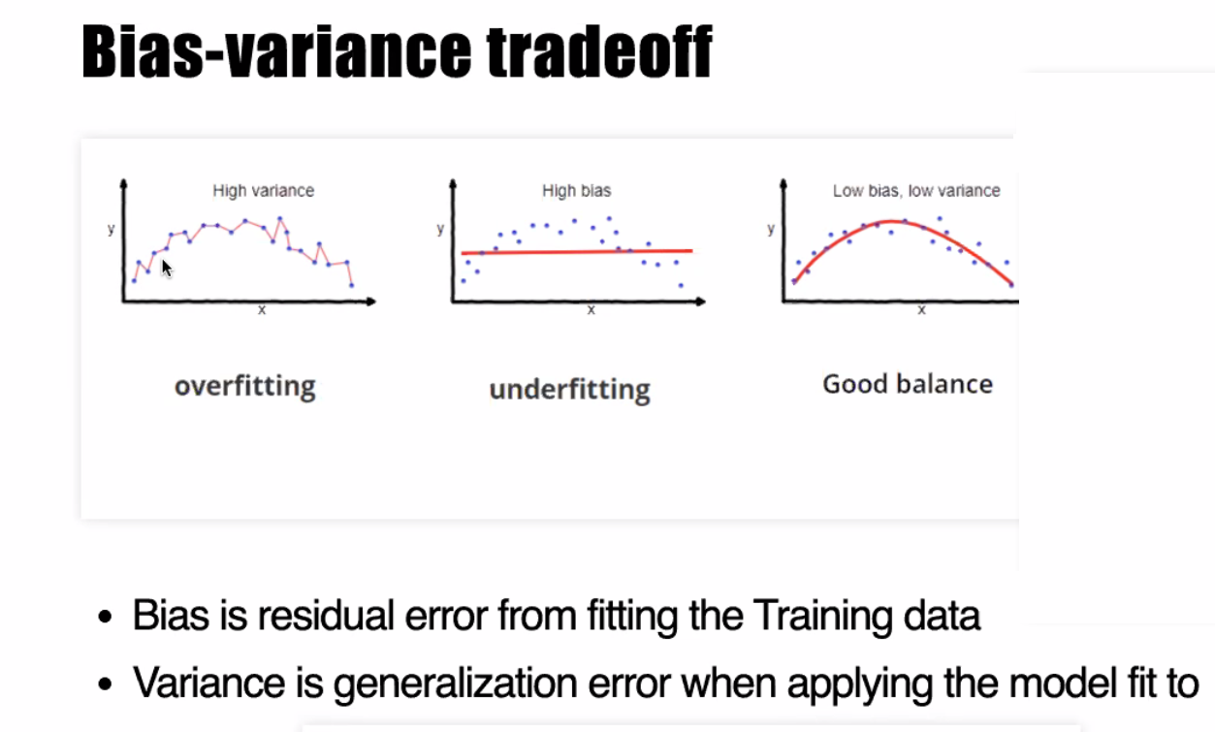
A fundamental concept in machine learning
Notes:
One thing I want you to memorize; please commit this to memory

Slide 3
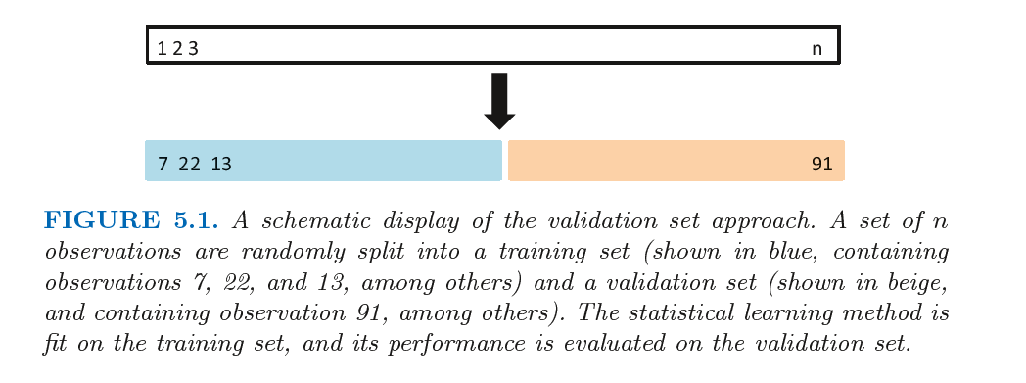
A fundamental concept in machine learning
An Introduction to Statistical Learning with Applications in R

Slide 4
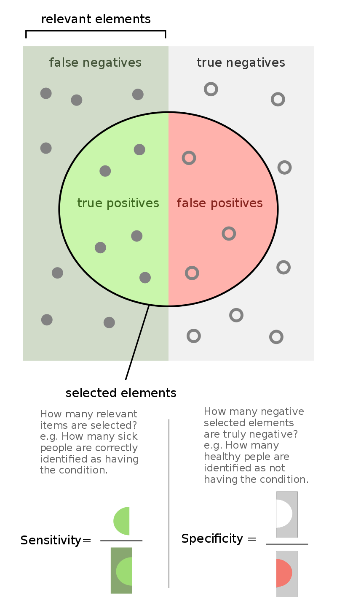
Hypothesis
West et al., Nature Medicine, 2017
Notes:
What happens if we use a simple classifier that just predicts randomly on a disease? For example, say you are trying to predict a particular disease. Each person has for each person. Assume you have features like age, gender and medications. You have to predict whether this patient will get a disease or not. As even the disease occurs in 90% of the population. How should you build your algorithm? What metric should you look at?
Answer: You should look at class-specific error (sensitivity/specificity). This is unbalanced data. Even an algorithm that randomly outputs 1 that is the person has disease, regardless of the input features, would give a 90% accuracy on the data.

Slide 5
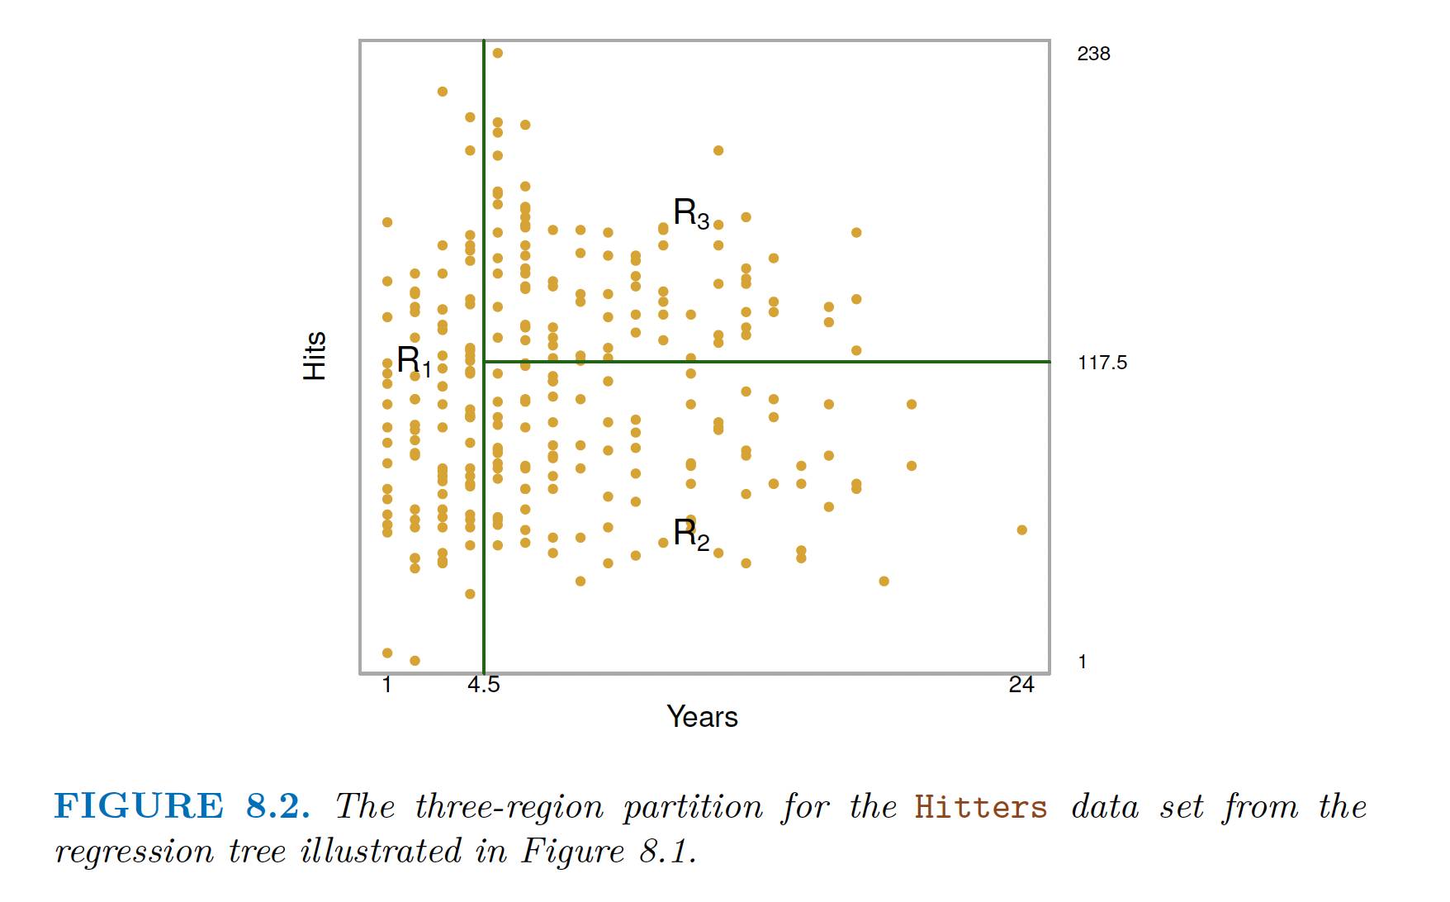
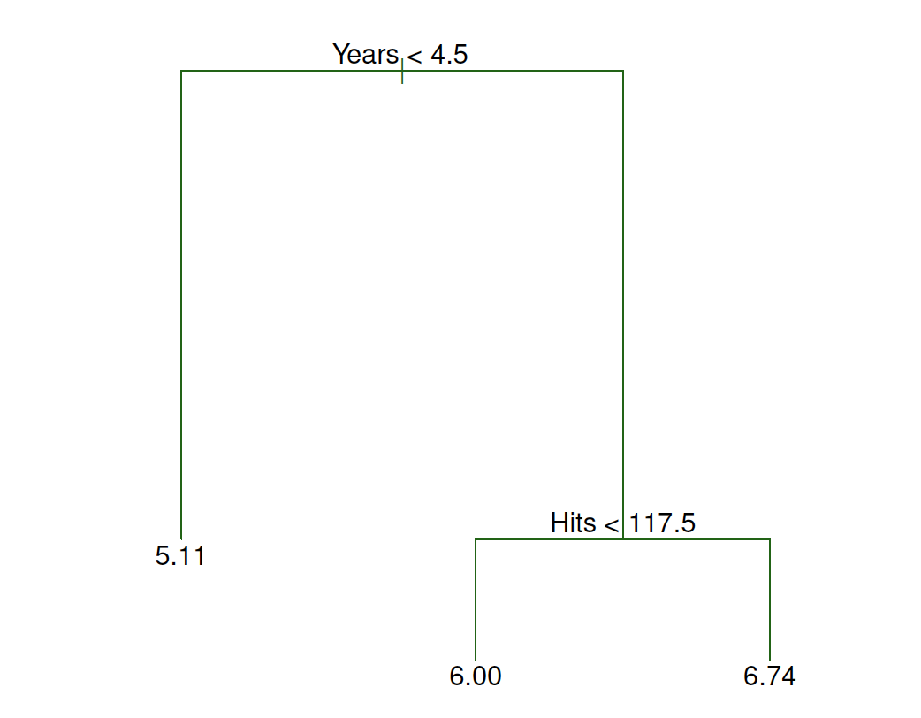
An Introduction to Statistical Learning with Applications in R
Notes:
What happens if we use a simple classifier that just predicts randomly on a disease? For example, say you are trying to predict a particular disease. Each person has for each person. Assume you have features like age, gender and medications. You have to predict whether this patient will get a disease or not. As even the disease occurs in 90% of the population. How should you build your algorithm? What metric should you look at?
Answer: You should look at class-specific error (sensitivity/specificity). This is unbalanced data. Even an algorithm that randomly outputs 1 that is the person has disease, regardless of the input features, would give a 90% accuracy on the data.

Slide 6
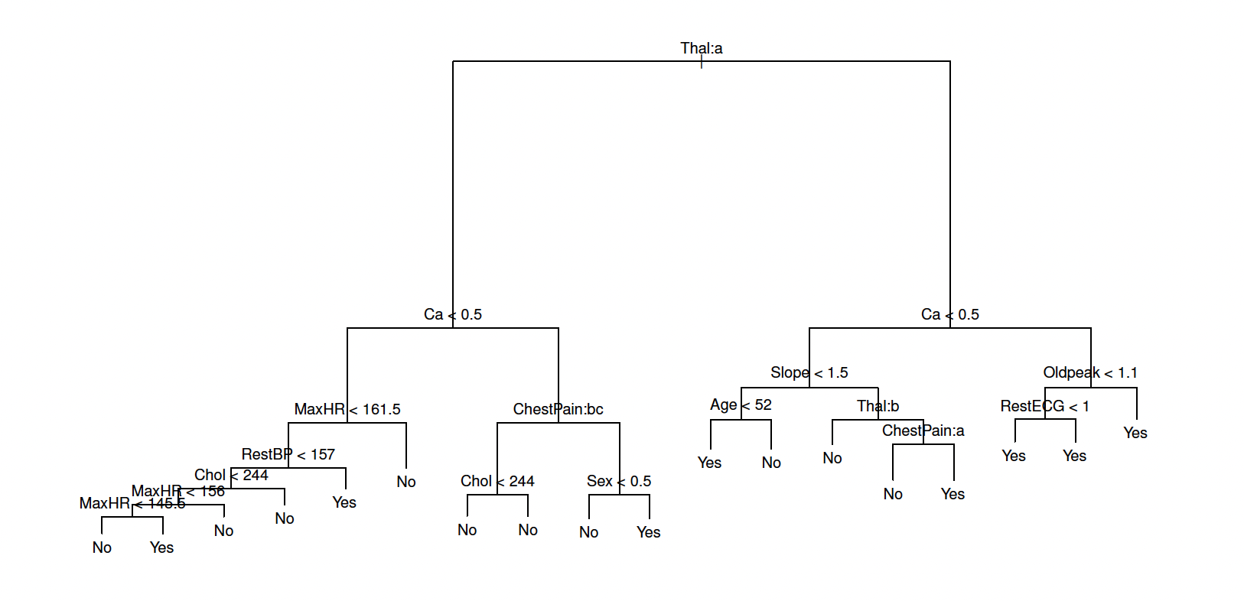
An Introduction to Statistical Learning with Applications in R
Notes:
What happens if we use a simple classifier that just predicts randomly on a disease? For example, say you are trying to predict a particular disease. Each person has for each person. Assume you have features like age, gender and medications. You have to predict whether this patient will get a disease or not. As even the disease occurs in 90% of the population. How should you build your algorithm? What metric should you look at?
Answer: You should look at class-specific error (sensitivity/specificity). This is unbalanced data. Even an algorithm that randomly outputs 1 that is the person has disease, regardless of the input features, would give a 90% accuracy on the data.

Slide 7
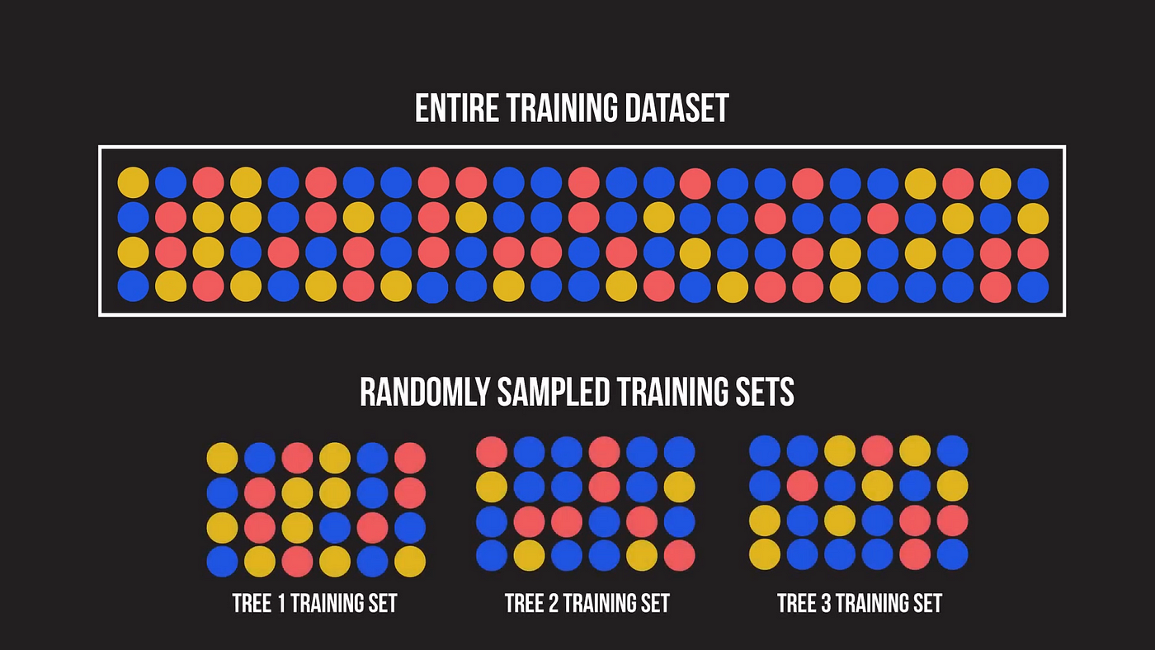
https://towardsdatascience.com/a-visual-guide-to-random-forests-b3965f453135

Slide 8
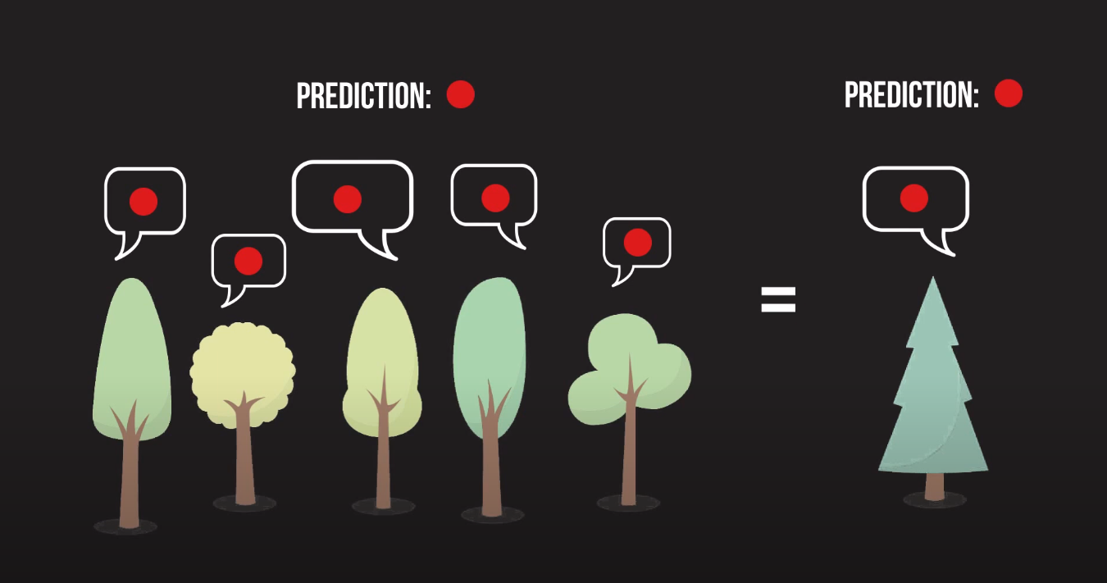
Random Forests
https://towardsdatascience.com/a-visual-guide-to-random-forests-b3965f453135

Slide 9
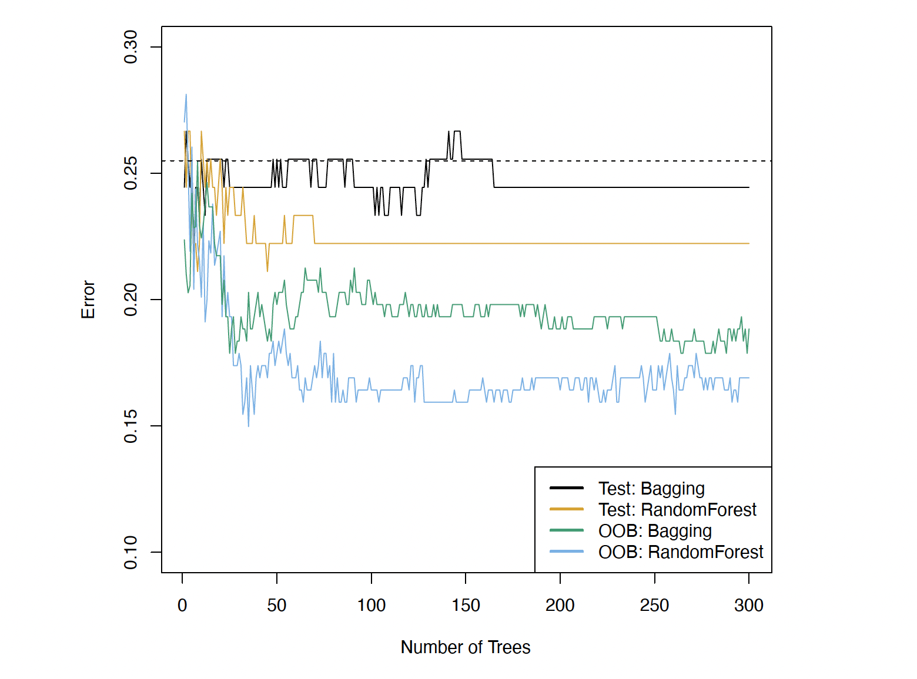
An Introduction to Statistical Learning with Applications in R
Notes:
What happens if we use a simple classifier that just predicts randomly on a disease? For example, say you are trying to predict a particular disease. Each person has for each person. Assume you have features like age, gender and medications. You have to predict whether this patient will get a disease or not. As even the disease occurs in 90% of the population. How should you build your algorithm? What metric should you look at?
Answer: You should look at class-specific error (sensitivity/specificity). This is unbalanced data. Even an algorithm that randomly outputs 1 that is the person has disease, regardless of the input features, would give a 90% accuracy on the data.

Slide 10
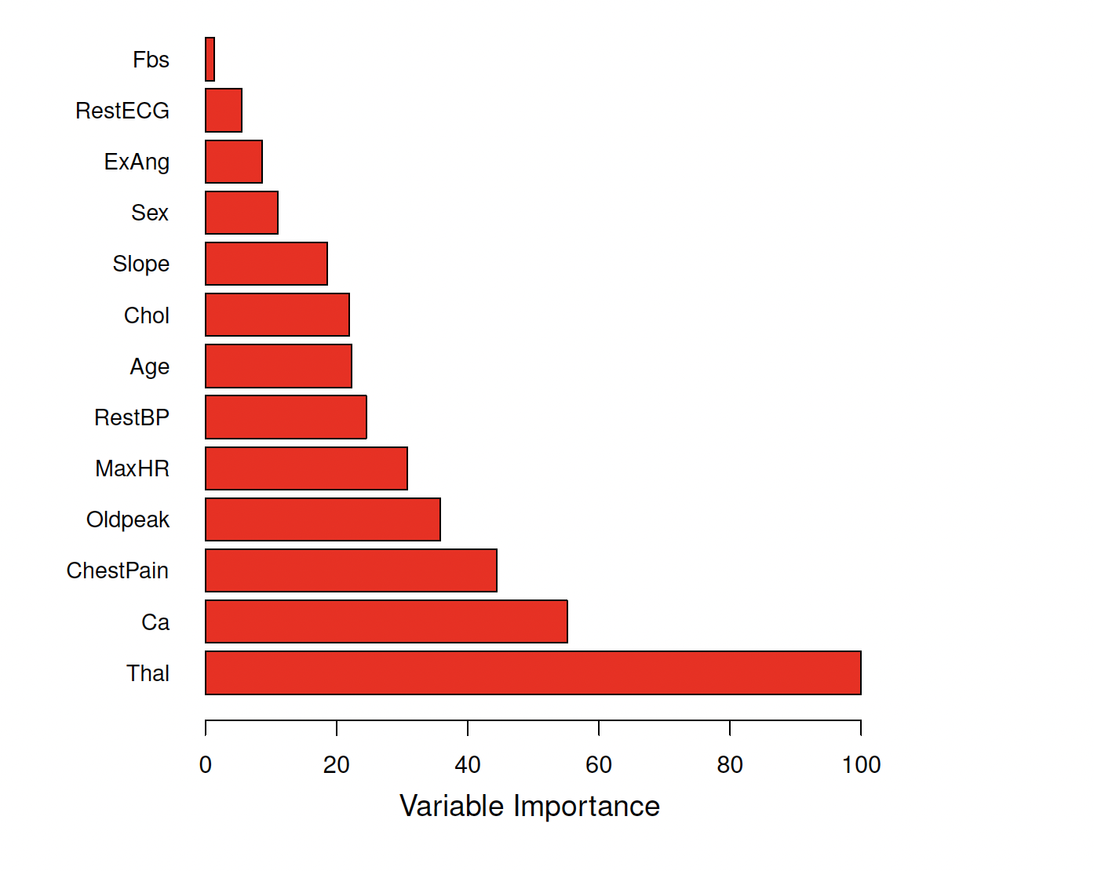
An Introduction to Statistical Learning with Applications in R
Notes:
What happens if we use a simple classifier that just predicts randomly on a disease? For example, say you are trying to predict a particular disease. Each person has for each person. Assume you have features like age, gender and medications. You have to predict whether this patient will get a disease or not. As even the disease occurs in 90% of the population. How should you build your algorithm? What metric should you look at?
Answer: You should look at class-specific error (sensitivity/specificity). This is unbalanced data. Even an algorithm that randomly outputs 1 that is the person has disease, regardless of the input features, would give a 90% accuracy on the data.

Slide 11
Notes:
What happens if we use a simple classifier that just predicts randomly on a disease? For example, say you are trying to predict a particular disease. Each person has for each person. Assume you have features like age, gender and medications. You have to predict whether this patient will get a disease or not. As even the disease occurs in 90% of the population. How should you build your algorithm? What metric should you look at?
Answer: You should look at class-specific error (sensitivity/specificity). This is unbalanced data. Even an algorithm that randomly outputs 1 that is the person has disease, regardless of the input features, would give a 90% accuracy on the data.

Slide 12
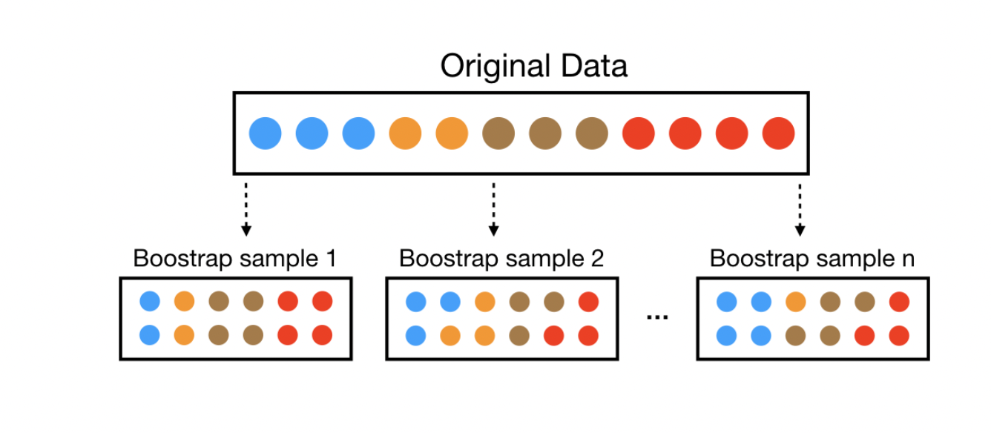
Bagging
https://bradleyboehmke.github.io/random-forest-training/slides-source.html#33

Slide 13
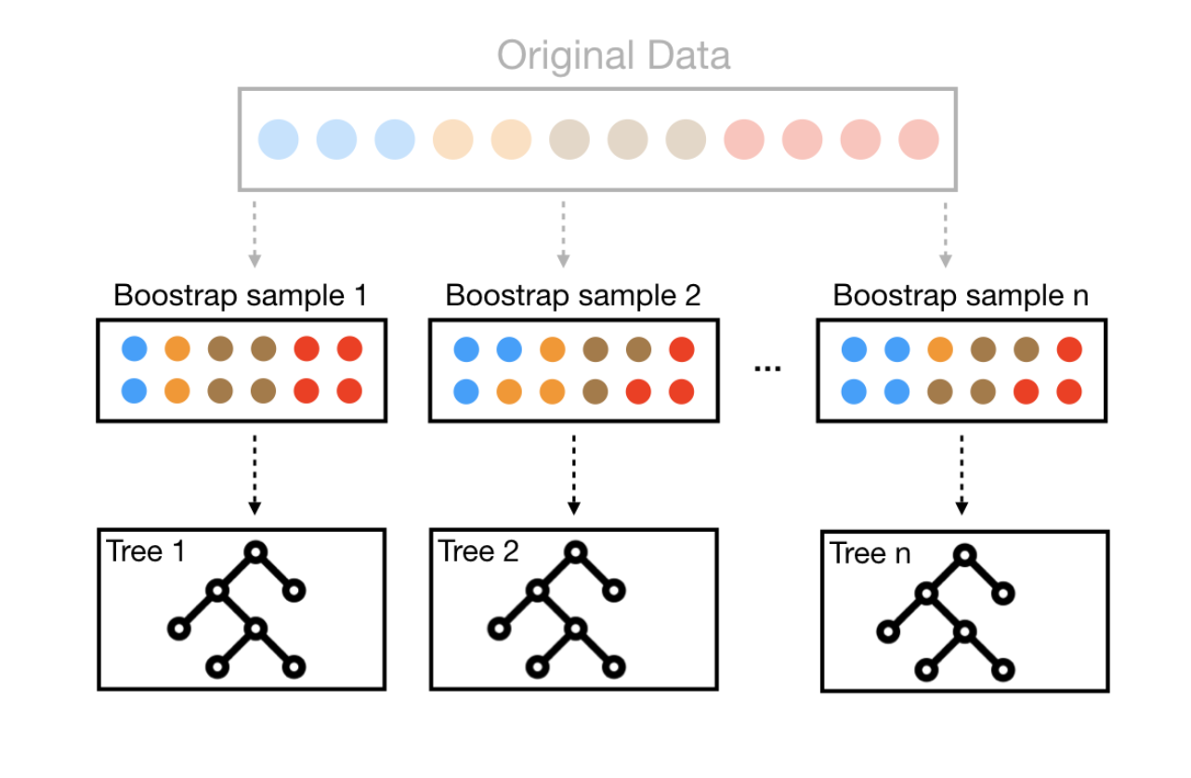
Bagging
https://bradleyboehmke.github.io/random-forest-training/slides-source.html#33

Slide 14
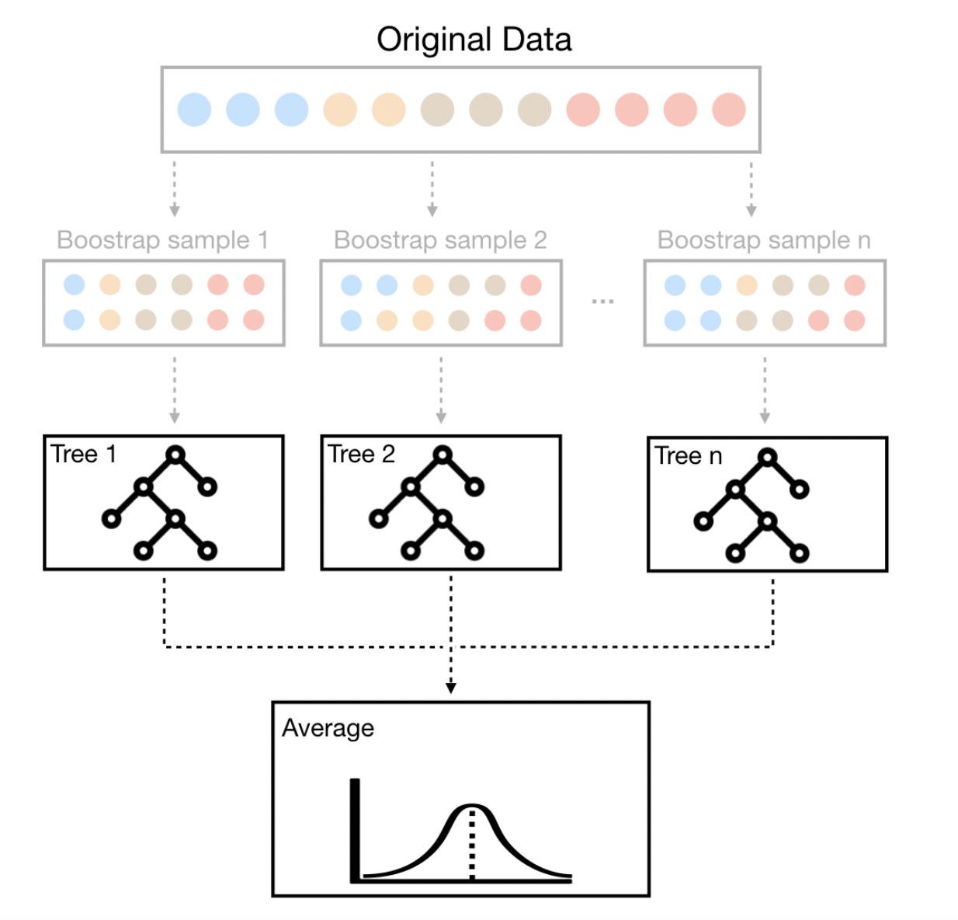
Bagging
1. How would you cross-validate?
2. Can this lead to any problems?

Slide 15
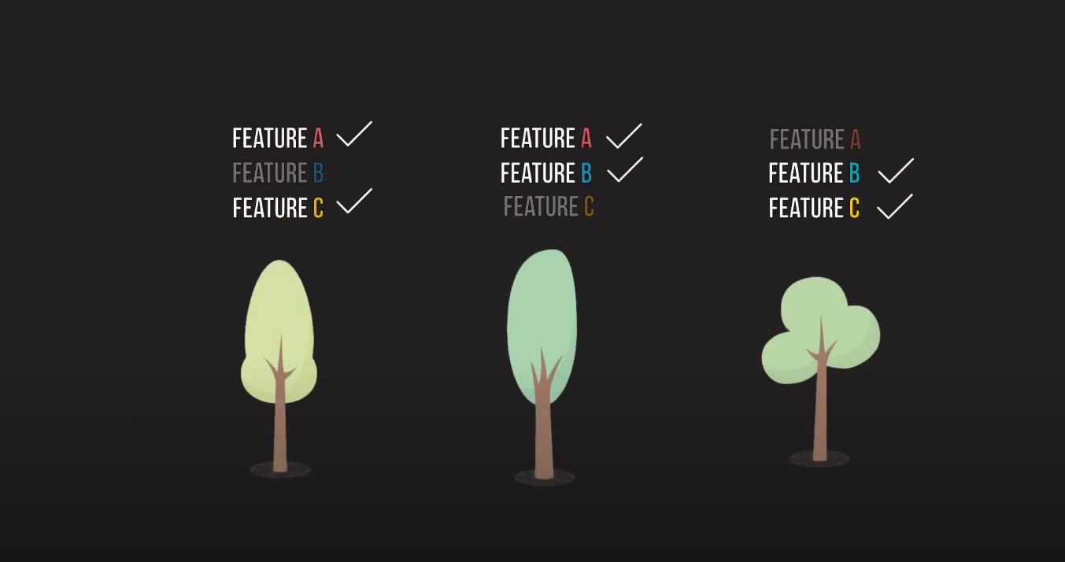
Solution
https://towardsdatascience.com/a-visual-guide-to-random-forests-b3965f453135

Slide 16
Random forests + Bagging
Decorrelate trees
When deciding on a split, a random sample of features is taken
Each tree is built on a different random sample of features!

Slide 17
Question
What happens if we use a simple classifier that just predicts randomly on a disease?
For example, say you are trying to predict a particular disease.
Assume you have features like age, gender and medications.
You have to predict whether this patient will get a disease or not.
Assume the disease occurs in 90% of the population.
How should you build your algorithm? What metric should you look at?
Notes:
What happens if we use a simple classifier that just predicts randomly on a disease? For example, say you are trying to predict a particular disease. Each person has for each person. Assume you have features like age, gender and medications. You have to predict whether this patient will get a disease or not. As even the disease occurs in 90% of the population. How should you build your algorithm? What metric should you look at?
Answer: You should look at class-specific error (sensitivity/specificity). This is unbalanced data. Even an algorithm that randomly outputs 1 that is the person has disease, regardless of the input features, would give a 90% accuracy on the data.

Slide 18
Question
What happens if we use a simple classifier that just predicts randomly on a disease?
For example, say you are trying to predict a particular disease.
Assume you have features like age, gender and medications.
You have to predict whether this patient will get a disease or not.
Assume the disease occurs in 90% of the population.
How should you build your algorithm? What metric should you look at?
Answer: You should look at class-specific error (sensitivity/specificity).
a. This is unbalanced data.
b. Even an algorithm that randomly outputs 1 [the person has disease], (regardless of the input features), would give 90% accuracy on the data.
Notes:
What happens if we use a simple classifier that just predicts randomly on a disease? For example, say you are trying to predict a particular disease. Each person has for each person. Assume you have features like age, gender and medications. You have to predict whether this patient will get a disease or not. As even the disease occurs in 90% of the population. How should you build your algorithm? What metric should you look at?
Answer: You should look at class-specific error (sensitivity/specificity). This is unbalanced data. Even an algorithm that randomly outputs 1 that is the person has disease, regardless of the input features, would give a 90% accuracy on the data.

Slide 19
Question
What is the sensitivity for the cases we talked about?
What is the specificity?
Fixes to balance the data (downsample, etc.)
Notes:
What happens if we use a simple classifier that just predicts randomly on a disease? For example, say you are trying to predict a particular disease. Each person has for each person. Assume you have features like age, gender and medications. You have to predict whether this patient will get a disease or not. As even the disease occurs in 90% of the population. How should you build your algorithm? What metric should you look at?
Answer: You should look at class-specific error (sensitivity/specificity). This is unbalanced data. Even an algorithm that randomly outputs 1 that is the person has disease, regardless of the input features, would give a 90% accuracy on the data.

Slide 20
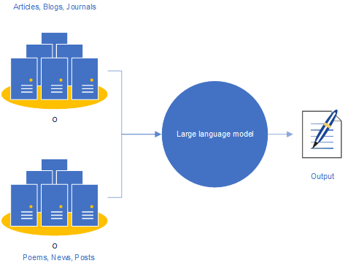
Applications of this concept
I saw a cat on a …
mat
https://becominghuman.ai/a-quick-introduction-to-the-large-language-model-chatgpt-a2f5f54b4d5e
Notes:
Say you are working in a startup and you have created a new model …… gizillions of parameters and less data. How would you …..

Slide 21
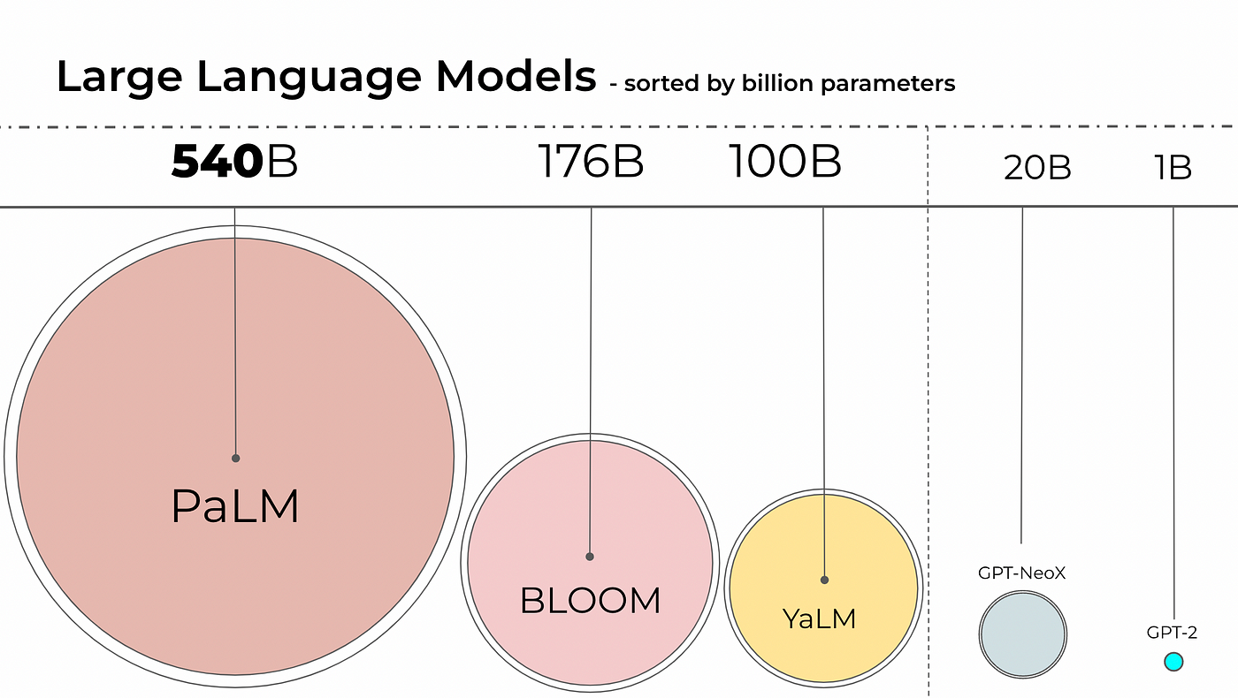
Applications of this concept
https://ashukumar27.medium.com/decoding-large-language-models-quantization-ff58964c0f31

